Slide 1

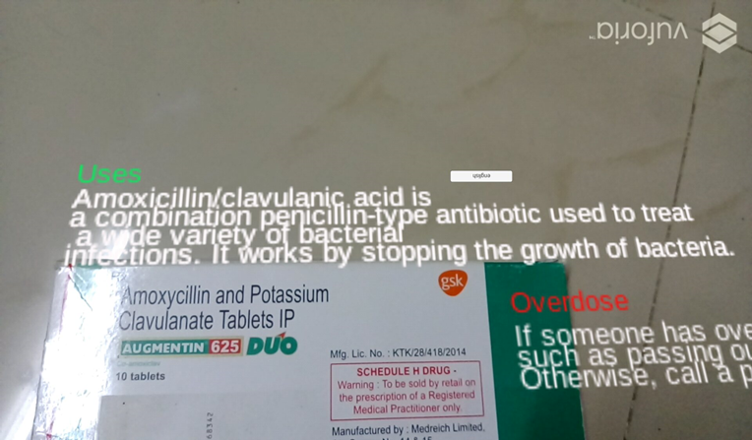
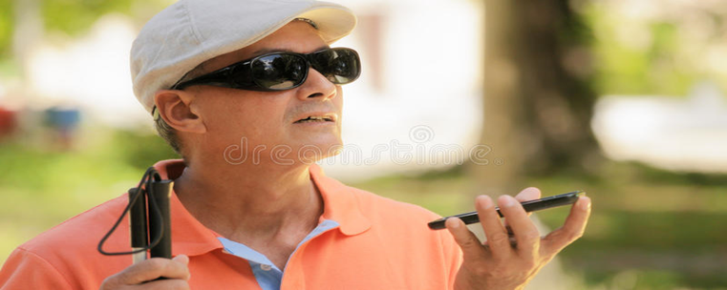
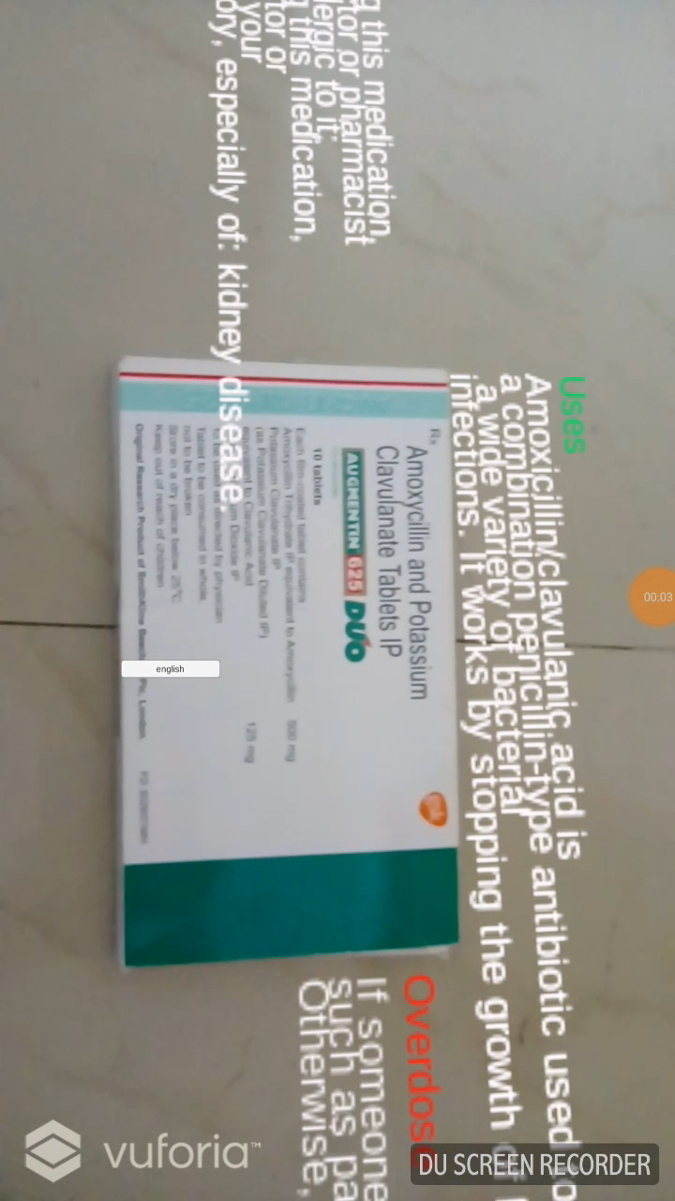
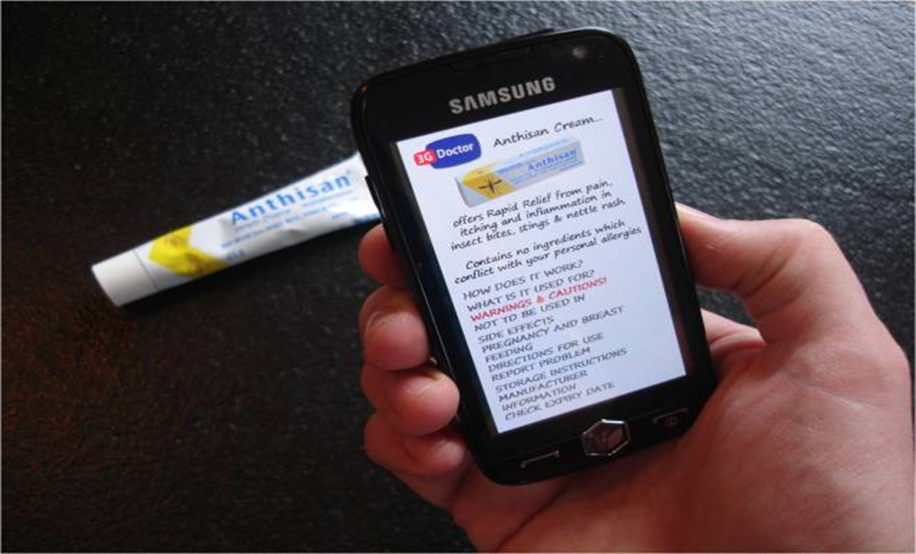
VALLURUPALLI NAGESWARA RAO VIGNANA JYOTHI
INSTITUTE OF ENGINEERING AND TECHNOLOGY
DEPARTMENT OF COMPUTER SCIENCE ENGINEERING
Medi-AR
Objectives:
To improve health literacy on many diseases and related medications.
For visually impaired the app gives voice-over of the medical description, purpose of drug and dosage...etc
Technologies Used:
C#
Unity
Features:
Gives all details about related drug
Voice-over for Visually impaired and illiterate People
Outcomes:
General awareness of drugs usage
Guide illiterates in differentiating the drugs

